Slide 1


Using R/RStudio for Data Science:
tidyverse overview
4/19/2022

Slide 2
What is R/RStudio?
R is a language for statistical computing and graphics. The R environment is an integrated suite of software packages used for data manipulation, calculation and visualization. It includes
an effective data handling and storage facility, where data does not leave the hard drive for computation or storage
a suite of operators for calculations on arrays, in particular matrices,
a large, comprehensible, integrated collection of tools for data analysis,
graphical facilities for data analysis and display either on-screen or on hardcopy, and
a well-developed, simple and effective programming language which includes conditionals, loops, user-defined recursive functions and input and output facilities.
RStudio is a free and open-source integrated development environment (IDE) for R, a programming language for statistical computing and graphics
Using R and RStudio | Hands-On Programming with R (rstudio-education.github.io)

Slide 3
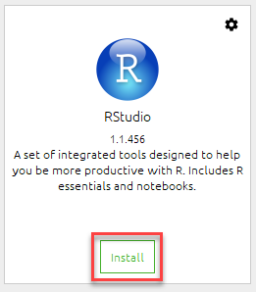
How to request R/RStudio
Request through Remedy: R/RStudio/Rtools latest versions
If in Econ, request through R3
2) Access through Anaconda navigator at home,
will not work perfectly on work computers
If you have trouble with installation, contact the CAT at CAT@census.gov for assistance

Slide 4
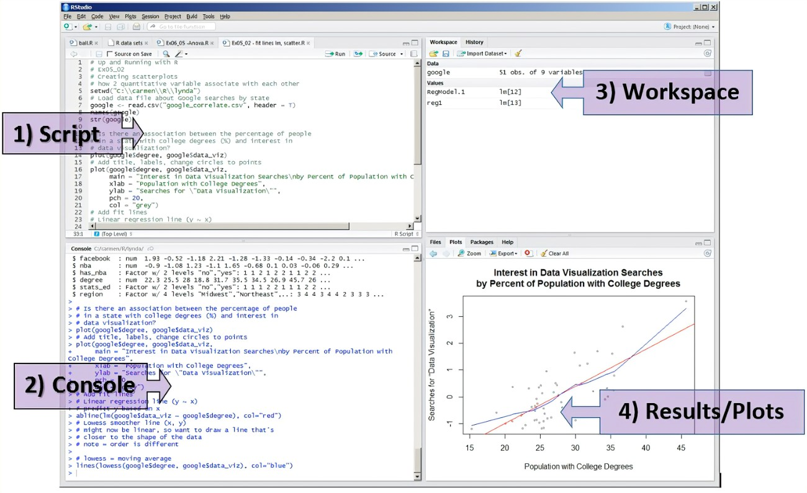
Navigating the interface
RStudio User Interface: 1) Script editor (notepad) 2) R Console (output) 3) Workspace and history 4) Plots and files (visualization)
A perfect RStudio layout | R-bloggers

Slide 5
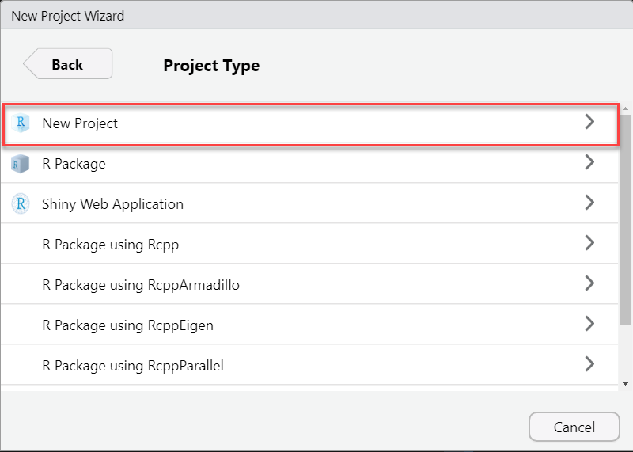
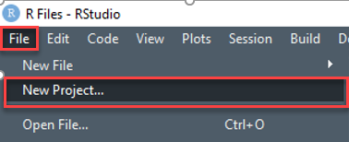
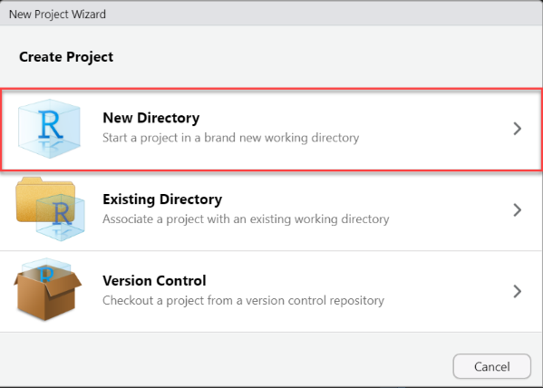
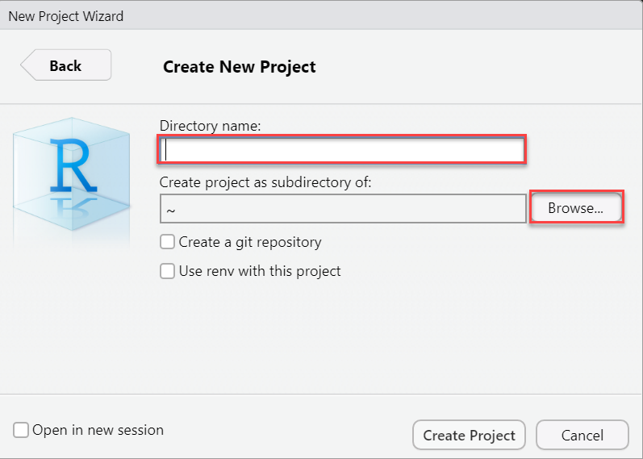
Start a new R Project
Open a new project and create a new directory
5
1
Save to new directory:
Four .R files
Three data files
2 .csv
1 .xlsx
3
2
Directory name:
R4DS
4
Browse to: C:/Users/jbidXXX/Desktop

Slide 6
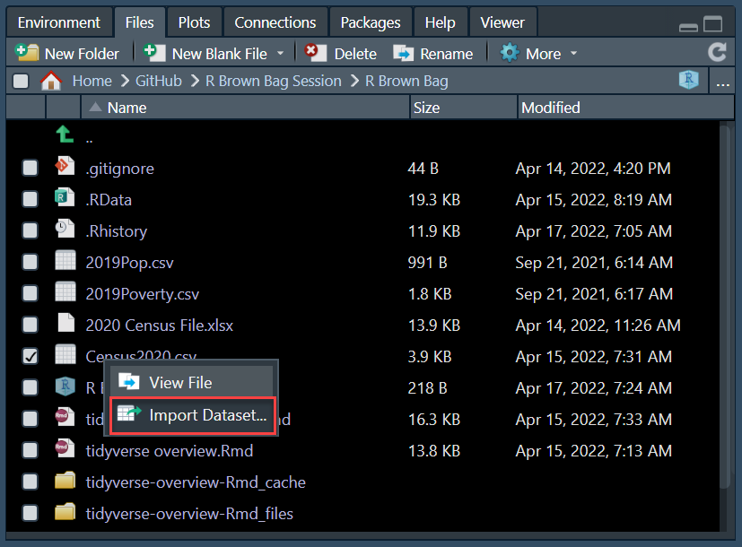
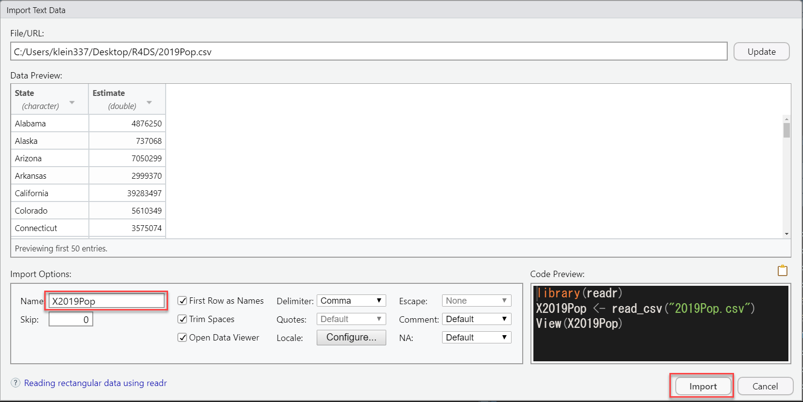
Import data from R Project
1
Click on data name, select import dataset
2
Change dataset name, and select import
Change dataset names from-to:
X2019Pop to Census2019
X2019Poverty to Poverty2019
X2020 Census File to Census2020

Slide 7
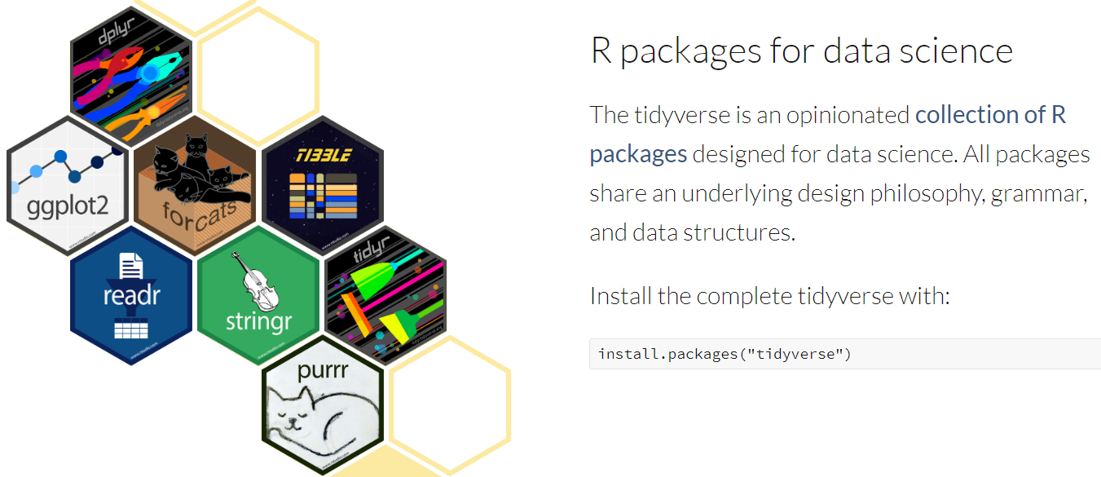
tidyverse ecosystem
Tidyverse
Easily Install and Load the Tidyverse • tidyverse
Welcome | R for Data Science (had.co.nz)
Learn the tidyverse

Slide 8
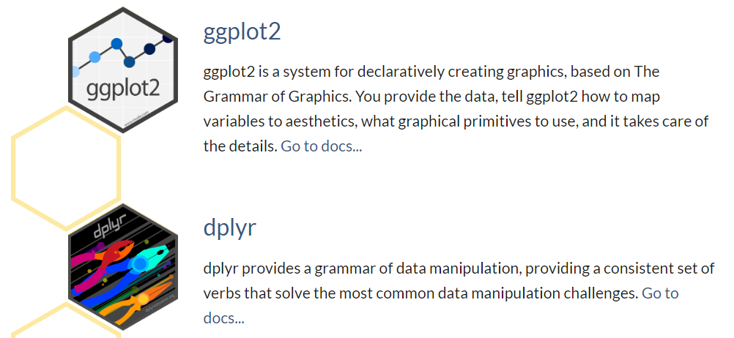
dplyr and ggplot2

Slide 9

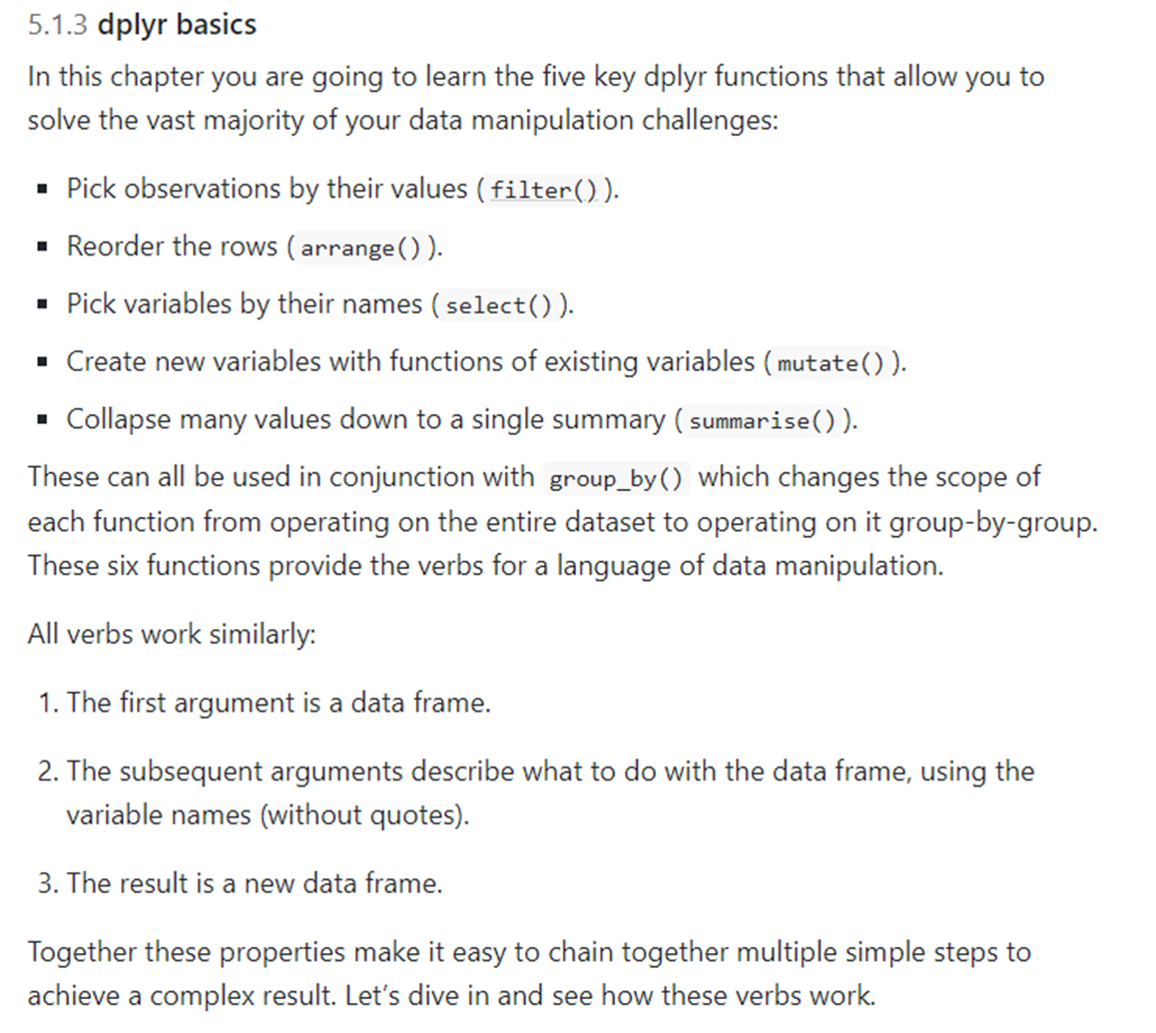
Source: 5 Data transformation | R for Data Science (had.co.nz)

Slide 10
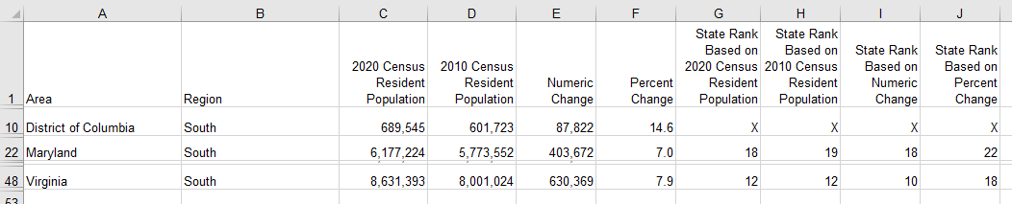
Census2020 data source
Census 2020 Population data for 50 states plus District of Columbia

Slide 11
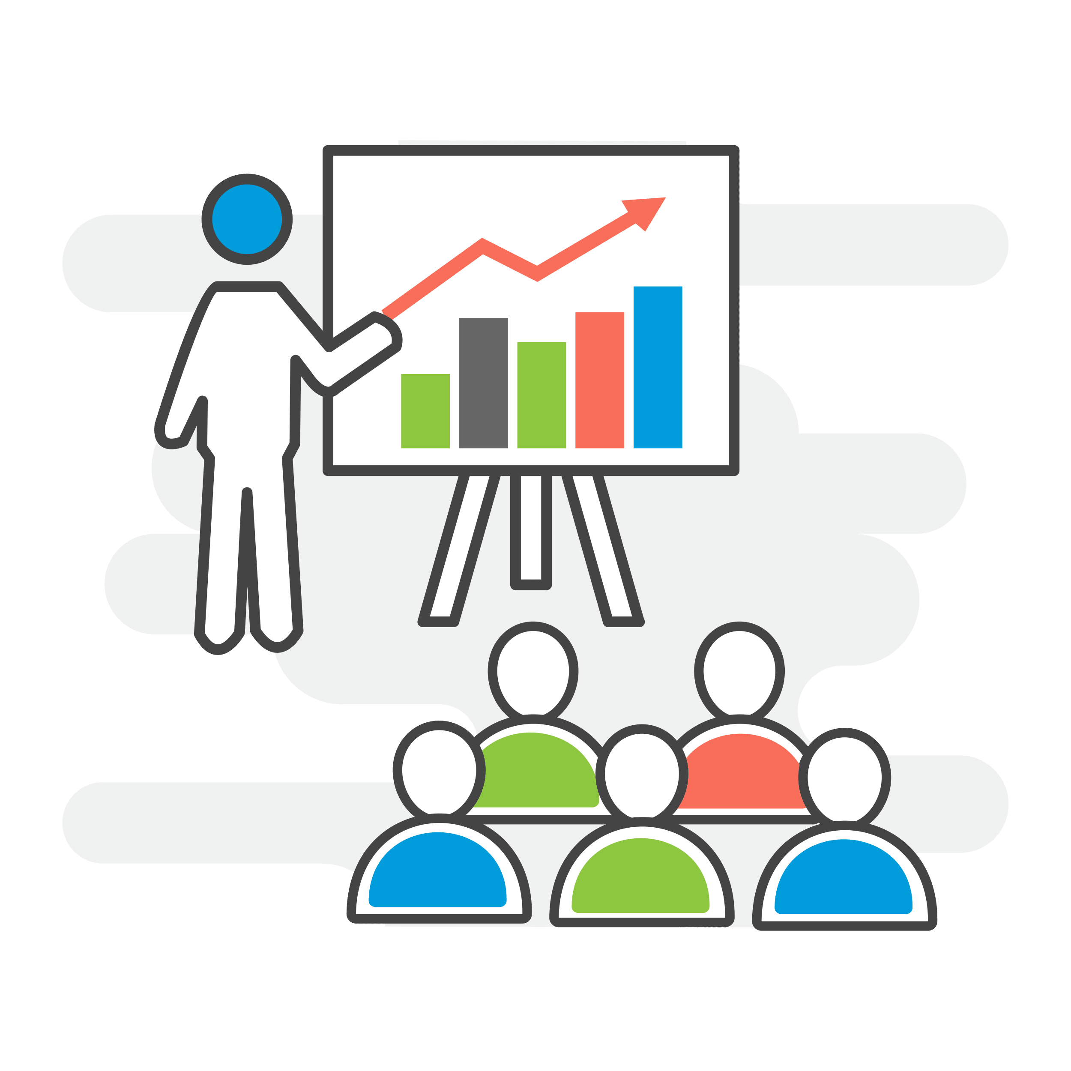
RStudio and tidyverse demo

Slide 12
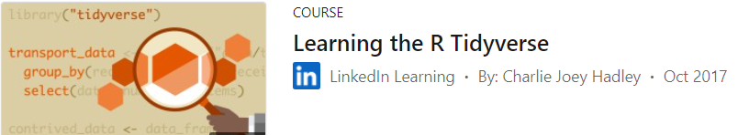
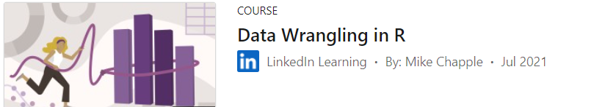
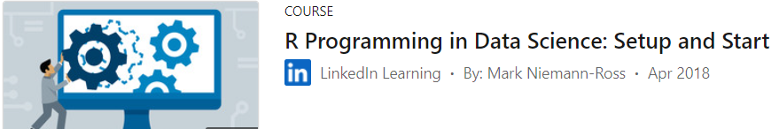
Linkedin classes to learn more

Slide 13
R/Python integration demo

Slide 14
Keep learning
RStudio Cheatsheets: Cheat sheets for all packages imaginable
Swirl Stats Package: Interactive hands-on lessons within RStudio
RStudio Education: Trainings curated by RStudio employees
Welcome | R for Data Science: All content from this demonstration was inspired from this book. It is a fantastic resource, please check it out.
Join the Census Bureau R Users Group (CBRUG); our Teams site has plenty of resources and friendly users to collaborate with
Schedule some time with the CAT for one-on-one instruction: cat@census.gov
Questions? Please reach out to:
Jessica.marie.Klein@census.gov
Cecile.mcwilliams.murray@census.gov

